Slide 1


Apr 2, 2022
Instructor: Parsa, Rajabi
Group 4: Joon, Hahn. Christopher, Tan. Hector, Onato

Slide 2
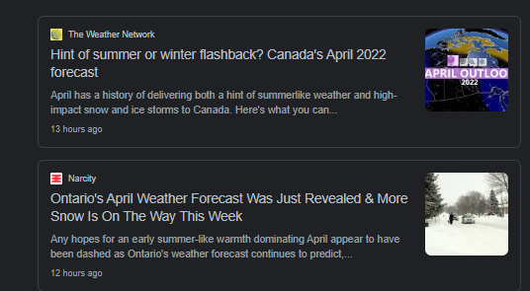
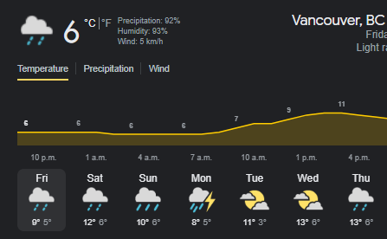
Overview
Weatherly is a web application that suits all your needs regarding the weather. It lets the user select a city and display the cities' weather while showing daily, hourly, and current forecasts, accurate to the minute. This information will range from the high and low temperatures, wind speed, visibility, and the weather. Aside from forecasts, the application can also serve as a way to consume your weather reports, as the homepage displays weather related news of the entered city from the previous weeks. All of this information can be accessed in a single click, simply by entering the city name to the field provided.

Slide 3
APIs
1_ One call API:
Makes a single API call to get current forecasts and historical weather data in a JSON format
2_News API:
Searches for news in a specific time frame from multiple sources by using keywords and setting a
3_Geocoding API:
Converts addresses represented by a string into geographic coordinates
4_Heroku API
Allows us to deploy our application

Slide 4
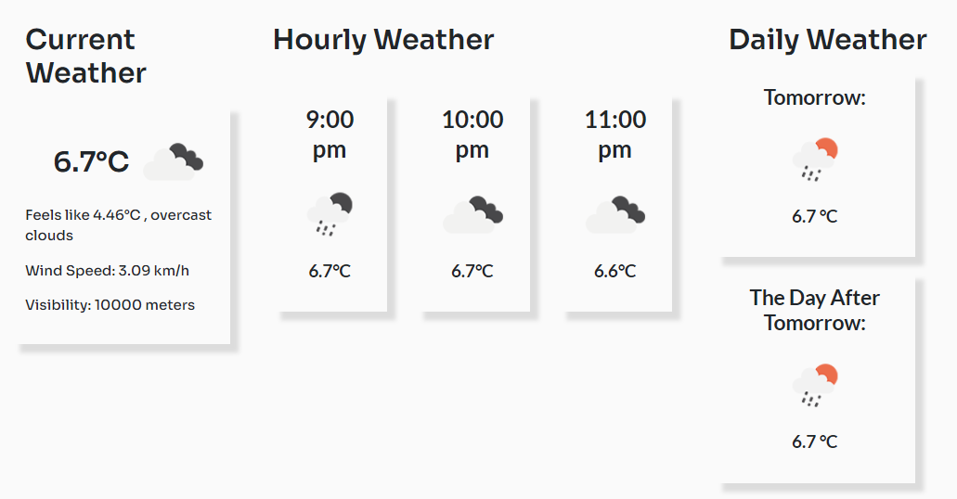
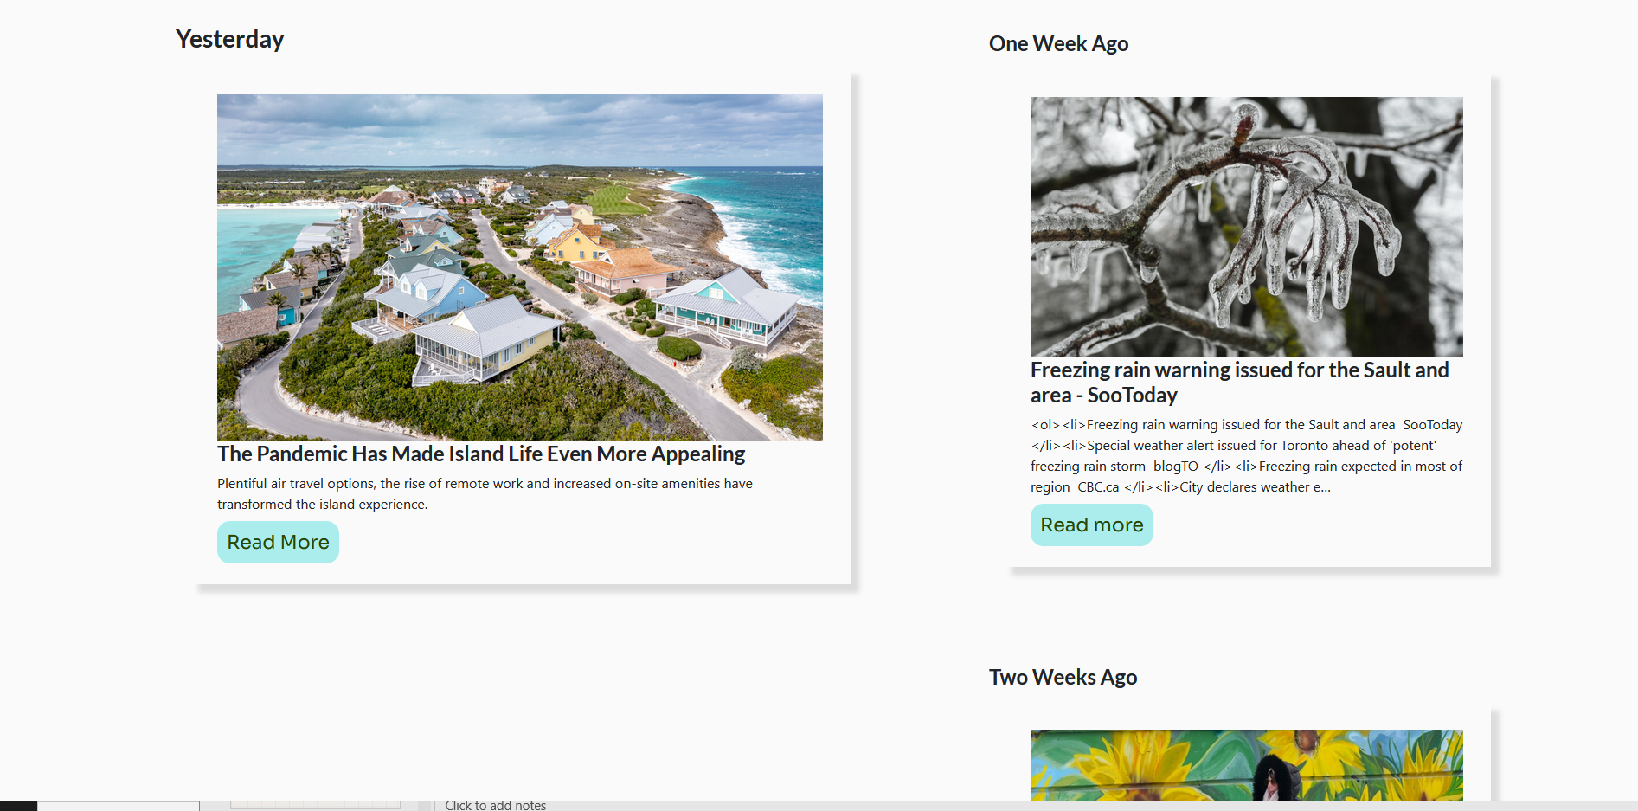
High level features
Allows users to look up the forecasts of a specified city by entering the location into the text field provided
Displays minute, hourly, and daily forecasts when a valid city is entered
Displays weather related news from the day before and some from previous weeks

Slide 5
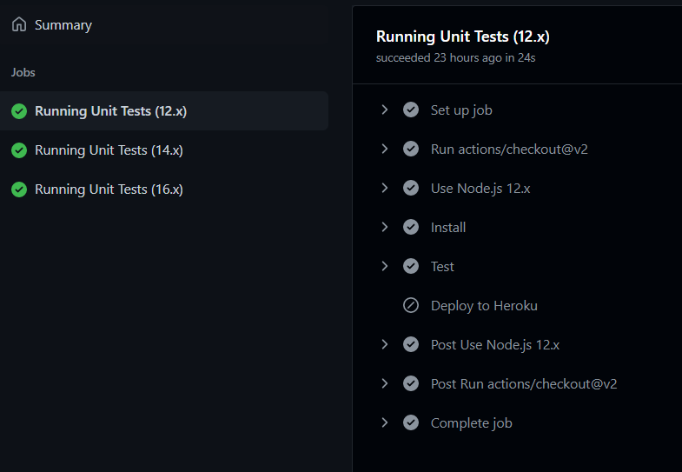
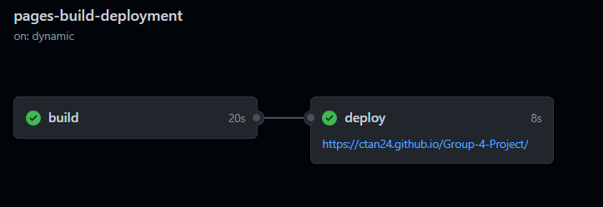
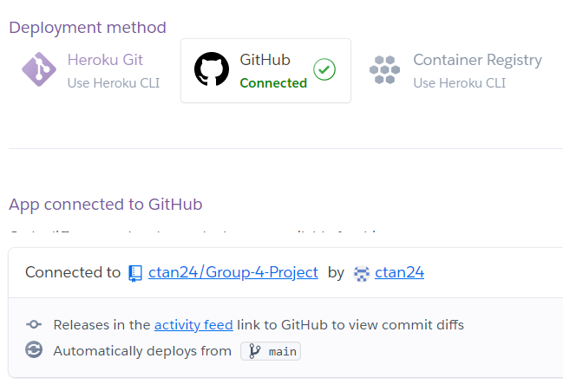
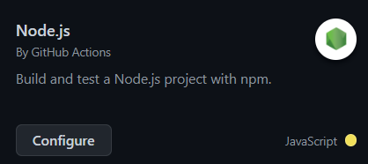
CI/CD Infrastructure

Slide 6
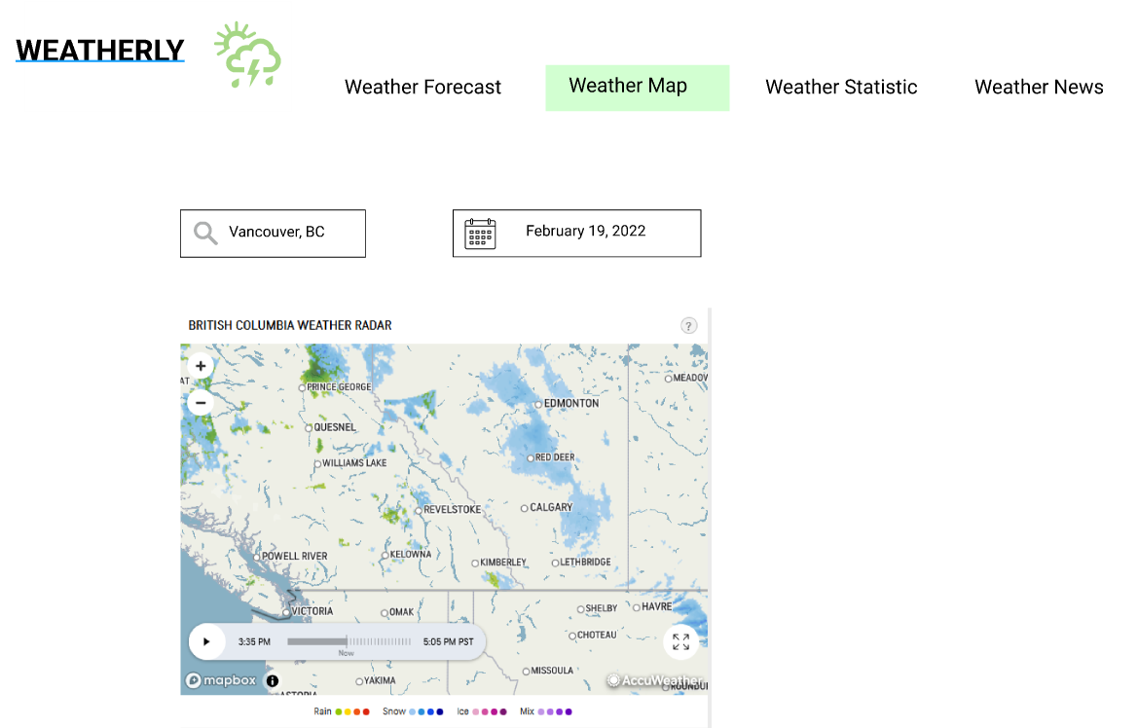
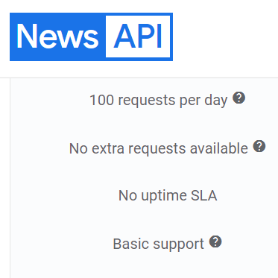

Challenges
Overpromised features
Choice of technology stack
Time constraints
Problem with the news API

Slide 7
Takeaway
Define scope &
TECHNOLOGY STACK
SDLC: Prototyping -> AGILE

Slide 8
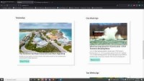
Demo

Slide 9
Thank you

